Slide 1

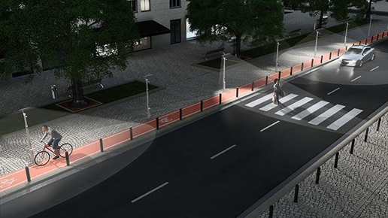
INTer Department PROJECT on AUTOMATIC STREET LIGHT CONTROLler
Under The Esteemed Guidance Of :-
Ms. SD. Shareefunnisa (CSE Dept.)
Dr. N.Ananda Rao (ECE Dept.)
Presented by:-
Nitish Kumar (201FA04433)
Dipu Kumar (201FA04432)
P.Vaseema (201FA05071)
Monu Kumar (201FA05092)

Slide 2
Contents
Abstract
Introduction
Existing system
Proposed system
Component of Proposed system
Block diagram
Conclusion
References

Slide 3
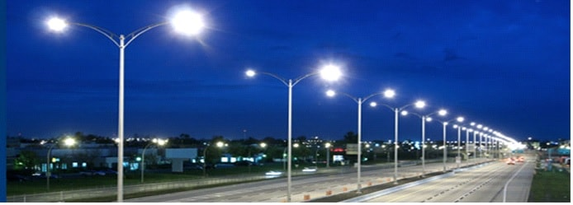
Abstract
This project aims at designing and executing the advanced development in embedded systems for energy saving of street lights.
Nowadays, human has become too busy, and is unable to find time even to switch the lights wherever not necessary.
The present system is like, the street lights will be switched on in the evening before the sun sets and they are switched off the next day morning after there is sufficient light on the roads.
Also, the manual operation of the lighting system is completely eliminated.

Slide 4
Introduction
The idea of designing a new system for the streetlight that do not consume huge amount of electricity and illuminate large areas with the highest intensity of light is concerning each engineer working in this field. Providing street lighting is one of the most important and expensive responsibilities of a city.
Lighting can account for 10–38% of the total energy bill in typical cities worldwide. Street lighting is a particularly critical concern for public authorities in developing countries because of its strategic importance for economic and social stability.
Inefficient lighting wastes significant financial resources every year, and poor lighting creates unsafe conditions. Energy efficient technologies and design mechanism can reduce cost of the street lighting drastically

Slide 5
Manual control is prone to errors and leads to energy wastages and manually dimming during mid night is impracticable.
The light sensor will detect darkness to activate the ON/OFF switch, so the streetlights will be ready to turn on and the photoelectric sensor will detect movement to activate the streetlights
The project represents a new cost-effective solution for street light control systems. The control system consists of control circuitry, internet and electrical devices.
The system also includes the client-server mechanism where a user can directly interact with the web-based application to monitor the streetlight of any place from a single position.

Slide 6
Existance System
The current system of street lights consists of manual controls which need Human intervention to work upon.
This cause the loss of energy due to manual control, or the use of outdated technology.
These systems are designed in such a way that they could reduce their intensity of light and save energy as much as possible. These systems are made to use of HID (High Intensity Discharge).
These systems are designed in such a way that they could reduce their intensity of light and save energy as much as possible. These systems are made to use of HID (High Intensity Discharge).
Due to manual system one needs to turn the street lights ON or there is a time allotted during which the intensity of the system keeps on high and then turns the lights OFF when the sun rises up.

Slide 7
PROPOSED SYSTEM
This can be done by creating a new system which is Automated, Energy conserving and cheap.
This system will eliminate the system of manual control as the system will cause to light up when the ultrasonic value become less than our defined value.
Also, the light will automatically switch OFF when detected value of ultrasonic become greater than the defined value.
If the motion is detected here the intensity of light become greater for the particular time interval.
The consumed current and voltage reading can be stored in the cloud.
We using cloud is that we need not to enter the data manually the cloud will update the data automatically in daily manner.
We are using android app one for viewing the stored data in the cloud. Another way for if we find wastage of light in roads then we can ON/OFF the whole system by using this android app.

Slide 8
Components
Hardware
Arduino uno
IR Sensor
LDR
LED
Node MCU
Relay

Slide 9
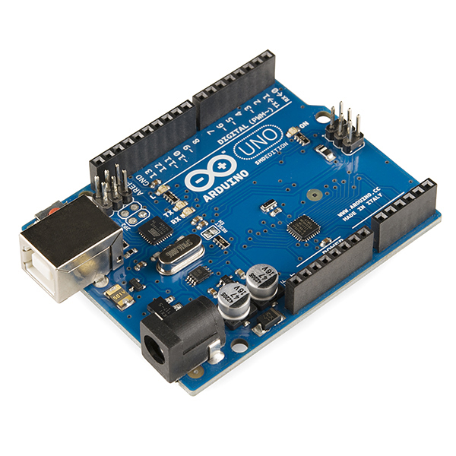
ARDUINO UNO
Arduino uno is a microcontroller board based on the ATmega328p. It has 14 digital input/output pins (of which 6 can be used as PWM outputs), 6 analog inputs, a 16MHz quartz crystal, a USB connection, a power jack, an ICSP header and a reset button. It contains everything needed to support the microcontroller.

Slide 10
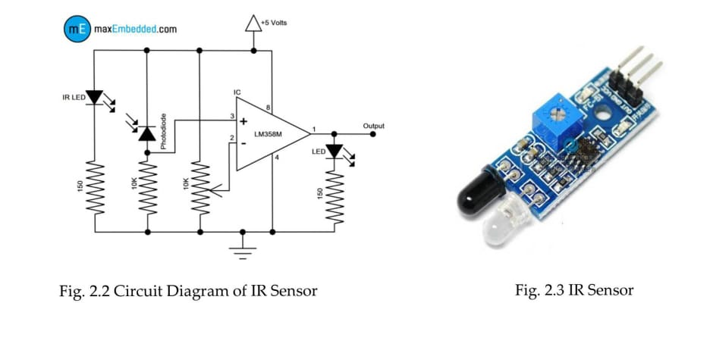
IR-Sensor
An infrared sensor is an electronic device that emits in order to sense some aspects of the surroundings.
An IR sensor can measure the heat of an object as well as detects the motion as well as the presence of an object due to intervention or interruption.
These type of sensors measure only infrared radiation, rather than emitting it that is called as a passive ir sensor.
Usually in the infrared spectrum, all the objects radiate some form of thermal radiations. These types of radiations are invisible to our eyes that can be detected by an infrared sensor.

Slide 11
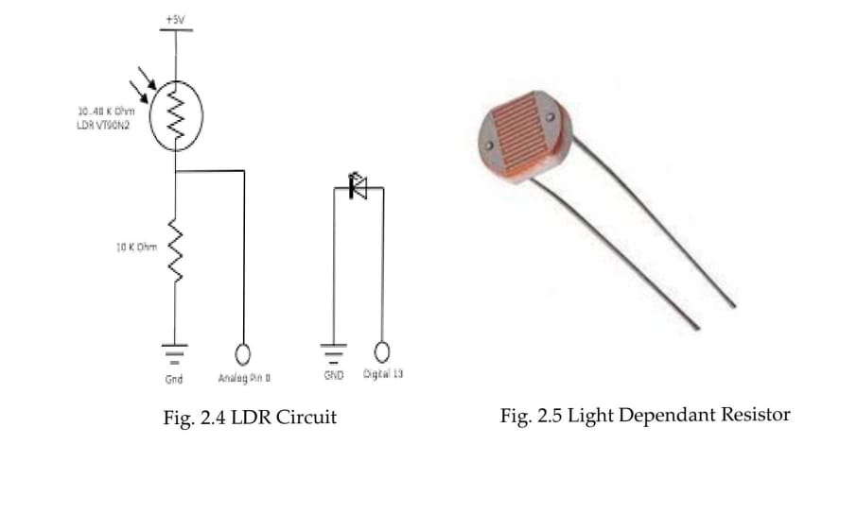
Light dependent resistor(LDR)
The LDR is a variable resistor whose resistance decreases with the increase in light intensity.
Two cadmium photoconductive cells with spectral response are very similar to that of the human eye.
The cell resistance falls with increasing light intensity.
Some of its features:
1) High reliability.
2) Light weight.
3) Wide spectral response.
4) Wide ambient temperature range.

Slide 12
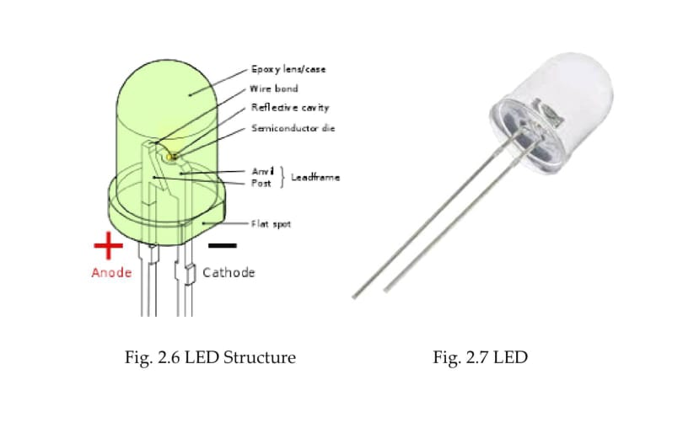
Light Emitting Diode (LED)
A light-emitting diode (LED) is a two-lead semiconductor light source. It is p-n junction diode that emits light when activated.The long terminal is positive and the short terminal is negative.
Led works on electroluminescence.
Led produce a focused light source and extra care should be used for your eyes ,though intensity is not very high.
While testing the led a resistance must be applied to it. Also, being a semiconductor device, they are sensitive to static charges.

Slide 13
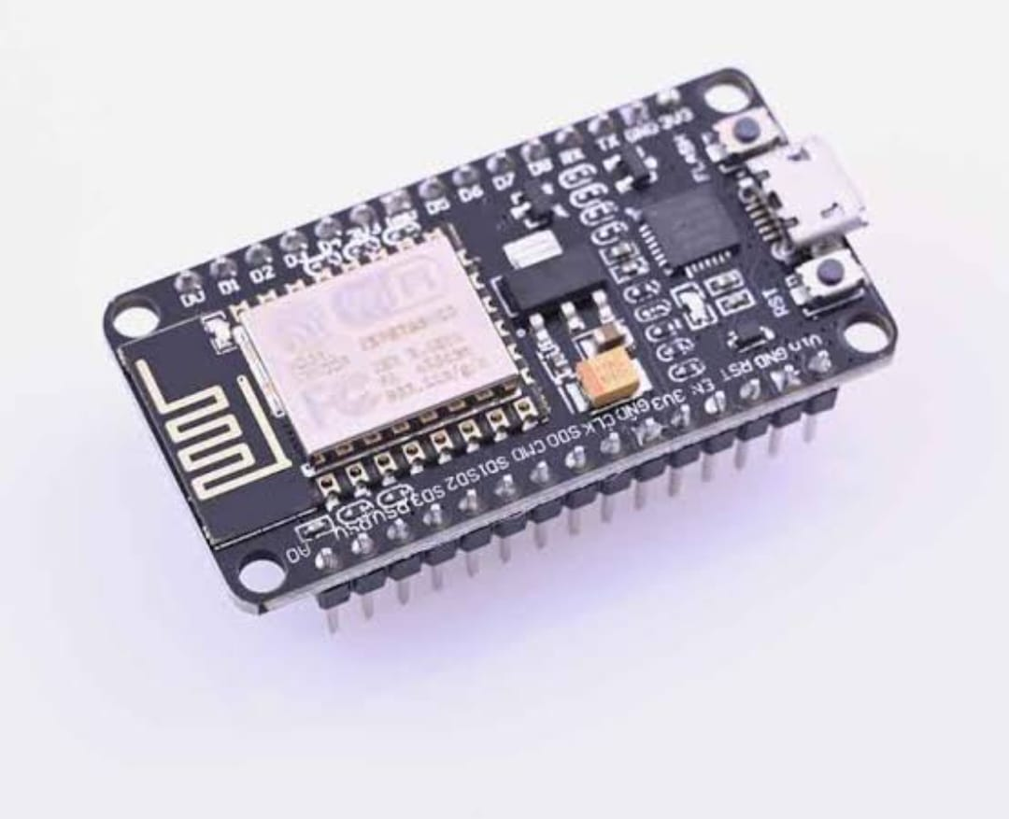
NodeMCU
NodeMCU is an open source platform based on ESP8266 which can connect object and let data transfer using the wifi protocol
Its providing some of the most important features of microcontroller such as GPIO,PWM,ADC etc
It has 17 GPIO pins which assigned for I2C,I2S,UART,PWM.
NodeMCU

Slide 14
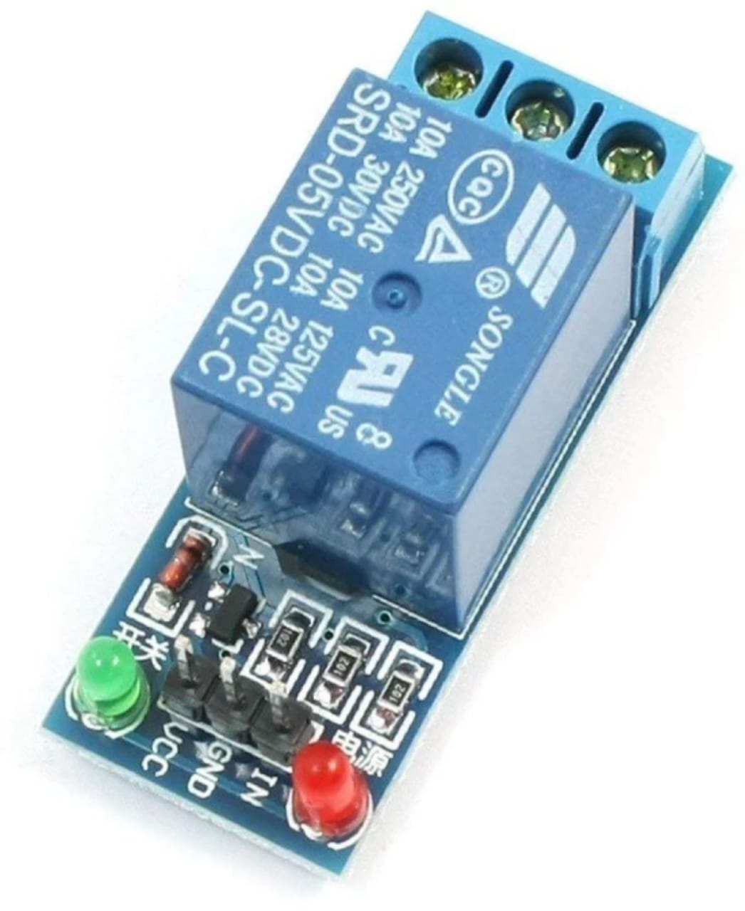
Relay
A relay is device that uses an electromagnet to open or close a circuit when the input is correctly excited.
Its provide a high level of isolation between the control signal and the output.
Relay

Slide 15
Block Diagram
230v
CF Bulb
Infrared
sensor
CT
Infrared
sensor
PT
Arduino
WIFI
LDR
cloud
Android

Slide 16
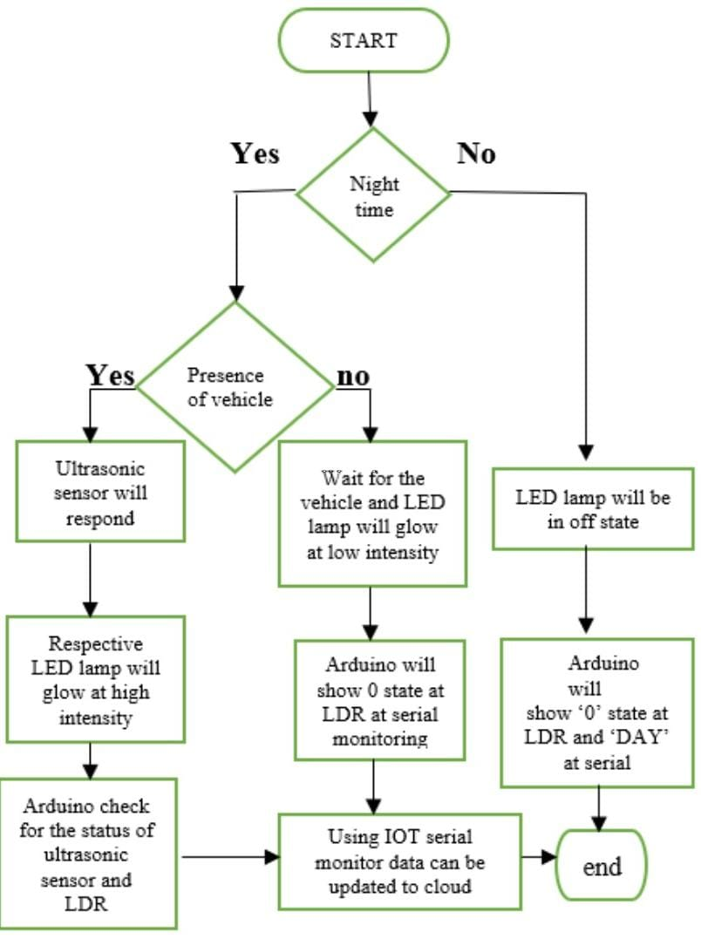
Software Component
1. Arduino IDE:
You will be needing Arduino IDE software
to write and upload the programming logic onto the Arduino Uno board
2.Programming language: C language && Assembly Language.
3 NODE MCU: All programming Language.

Slide 17
CONCLUSION
This project aims to find the solution of power consumption and manual working of the current system.
As we have aimed this project is working as expected in both forms i.e in university roads and in streets.
This system overcomes the drawback of current system of manual operation.
The light remains OFF or in Dim state as long as the motion is not detected. Once the motion is detected the lights comes to ON or bright state.
This system is solely made for using in a wide scale project. Also, it is very cheap.

Slide 18
REFERENCES
Payal Rodi, Leena Chandrakar, Saylee Ginde Sivanantham S and Sivasankaran K, “Energy Conservation using Automatic Lighting System using FPGA”, International Confernece on Green Engineering and Technologies, 2015.
Deepak Kumar Rath,” Arduino Based: Smart Light Control System”, International Journal of Engineering Research and General Science Volume 4, March- April, 2016.
Gouthami. C, Santosh. C, A. Pavan Kumar, Karthik. A, and Ramya.K.R, “Design and Implementation of Automatic Street Light Control System using Light Dependent Resistor”, International Journal of Engineering Trends and Technology (IJETT) – Volume 35 Number 10 - May 2016

Slide 19
THANK YOU

